Slide 1

An introduction
i2s Business Solutions India Pvt Ltd.
Presented by Krishnaraju, Rajasekhar and Gayathri

Slide 2
Who we are
Technology Enabler with a Strong Presence in South East Asia since 2006
Expanding our footprint in Middle East & Africa
Deep expertise in integration services and solutioning in a complex enterprise environment
Strong experience in Banking and Telecom industries
Premier Business Partner of IBM

Slide 3
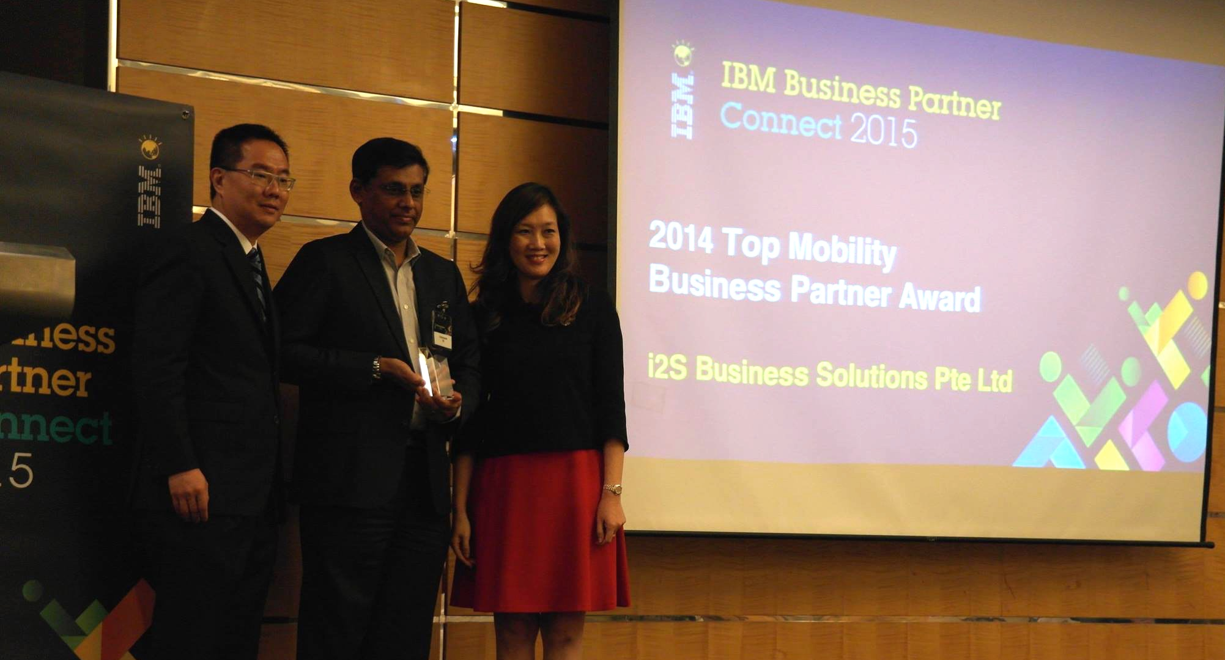



2014 Top Mobility Partner

Slide 4
Our journey so far
2006
2008
2013 - Beyond
Incorporated in the Philippines
Large Fixed Price Deals
Offshore development
Software license re-seller
Delivery capabilities added
Enterprise Marketing Management
Big Data
Datawarehouse
Incorporated in Malaysia
Time & material deals
Delivery capabilities added
Database management
Data integration
i2s incorporated in Singapore
Time & material deals
Delivery capabilities
Web Technologies
App Server
SOA & EAI
Grew footprint in South East Asia
Fixed Price deals
Delivery capabilities added
Portal
Business Intelligence
Content Management
IT Operations Management
Smarter Process
Solution Accelerators
Incorporated in India and Dubai
Managed services deal
Delivery capabilities added
Predictive Modelling
Mobile
Agile and DevOps
2007
2009 - 2012

Slide 5

Our global presence
Kuala
Lumpur
Bangkok
Manila
Dubai
Bangalore
Singapore
Office
Offshore Delivery Center

Slide 6
Key facts
50+
Clients in South East Asia and Middle East
2546
Projects executed since inception
35
Ongoing projects
175
Employees across all offices
Operating countries
15
Dedicated offshore development centers
2

Slide 7

What we do
Integration and Solutioning Services
in a complex enterprise environment
Market Relevant Technologies
Business Analytics, Mobile, Big Data, Enterprise Marketing Management, BPM, BI & Data Warehouse
Delivery Model
Use Solution Accelerators, Agile Delivery, and Value-add models
Resourcing
Solve tactical and strategic needs of clients through skilled resource deployment

Slide 8











Our clients in the region
Middle East & Africa
Notes:
Abu Dhabi – Ministry of Immigration – Message Broker service support - IBM
Dubai - Dubai Islamic bank – Netezaa training, GBM
Ooredoo – implemented a campaign management solution
Dubai - Mashreq – Sterling Commerce installation, GBM
Banagas – Bahrain – Informix supp thru BBM
Anadolu Sigorta - WESB support services
Akbank – training WESB support services

Slide 9





















Our clients by Industry domains
Banking
Banking
Insurance
Notes:
CIMB - iP
Apps on top of Lombardi and Process server - Account opening, remittance and loan originating services (LOS)
Later we retrofitted all of that for BPM 8.5
Tokyo Marine – Elxir based system – (indrect thru IBM) agent and public front end interface – using data stage, Cognos and pull all the data Elixir insirance eprocess system – developed a Portal – direct engagement for pushing data and pulling data from Informix.

Slide 10


















Our clients by Industry domains
Telecom
Banking
Public Sector
Notes:
Pretty large footprint – all Telcos in Thailand, all in the Philippines, 2-3 in Singapore, 2 or 4 in Malaysia
Badan Intelijen Negara (BIN) – call records and look for keywords. Bomb – scanner
Sri lanka – First BPM telco services – SLT
Singtel – Unica services – support – install and platform readiness campaign management services
Telkomsel – process server and MB product support
Smart, - Streams services - direct
AIS, - The Now Factory & streams – event management – SIFT – Novesis – event management software – event triggers – a certain action from the telco operator – nothing is there – targeted promotion.
True – campaign management
Celcom – campaign management
Maxis – SDP – provisioning system, Bodies for various technologies including Amdocs
1USACELL – SDP – outsourced and provisioning system 2011-12

Slide 11















Our clients by Industry domains
Healthcare
and more

Slide 12
Case Study (BPM)
Business Scenario:
Sales happens manually by visiting the customer premise or organisation. Sales information system provides the provisioning of customer order by providing incremental order information by obtaining formal approvals from respective departments for initiating the order there by delaying the order processing and also impact the revenue generation on the sales.
This was trigger point, where order processing invocation system was proposed to automate the interaction and workflow management in order to avoid any delays with approval process and enhance the customer satisfaction and revenue management.

Slide 13
Case Study (BPM)
Demo Scenario:
Demo Mainly focus on the credit evaluation process during the initiation of the order management system which happens in existing CRM application with integration with BPM.
Check for Customer eligibility for buying the Product, system will trigger the notification as a workflow management to Supervisor for approval process. Upon successful approval order is placed.
Customer request for sales person to provision the amendments for the delay in taking the decision to purchase a particular product.

Slide 14
Technology Experience
Systems | Analytics & IM | Cloud | EMM | Commerce | Security
Application Platform | BI | Cloud & IT Optimization | Customer Analytics | B2B commerce | Advanced fraud protection
IT Service Management | Performance Management | DevOps | Digital Marketing | B2C commerce | Application security
Integration | Predictive Analytics | Mobile | Omni-channel marketing | Customer analytics | Data security and privacy
Smarter Process | Prescriptive Analytics | Connectivity, integration and SOA | Omni-channel merchandising |  | Identity and access management
Digital Experience | IM & Big Data |  | Real-time personalization |  | Infrastructure protection
 | Risk Analytics |  |  |  | Security intelligence and analytics
Level of Expertise
End-to-end projects | Solution Implementation | Staff Augmentation | Can work with a Specialist Partner

Slide 15



Engagement models
Time & Material
Fixed Price Delivery
Managed Services
License Sales + Successful Deployment

Slide 16
i2s and IBM Services
IBM + i2s
Partnership
PM by IBM
i2s is the implementation partner
IBM Prime
Staff Augmentation
Tactical support to IBM Software Lab Services
T&M
i2s + IBM
I2s Prime
Seeks support from IBM Software Lab Services
i2s involved in sales process
Fixed Price arrangement
i2s identifies opportunities

Slide 17



What i2s stands for
Efficiency
Elasticity
Economy

Slide 18
Thank You

